Slide 1
Create a larger virtual disk 5 gigs diskmgmt.msc - action - create VHD - size - initialize – volume create database – redirect both data and log files to this drive (W)

Slide 2
What is a page split?
We talked about in the previous video that a page has 8060 bytes of free space for you to insert data rows and/or update existing rows. At times, when you insert more rows there may not enough room for the newly inserted row in the applicable data page.
If this happens, then SQL Server will have to move some of the data from the current data page and move it to a new data page.
This involves the normal I/O of inserting of a row, but at the same time involves updating any applicable indexes. This result in a lot of excessive I/O.
While a certain amount of page splits is normal and expected, too many page splits can cause performance issues.
In this video we shall set up a page split and in coming videos see ways to resolve excessive page splits

Slide 3
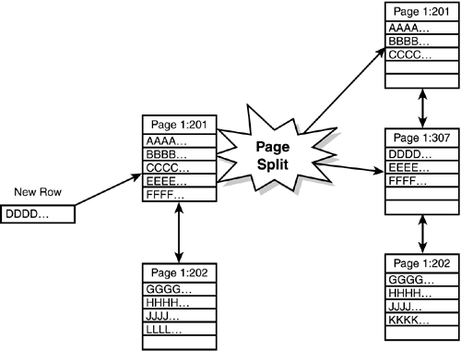
Diagram of a page split
This diagram illustrates a page split.
We can see that page 1:201 has five rows AAAA to FFFF not including DDDD
When you insert a new row (DDDD) in a sequential order for the page that has NO MORE room for row DDDD, the SQL Server splits the page 1:201 in half and creates a NEW page 1:307 IN BETWEEN 1:201 and page 1:202. SQL server now has to read more pages and update the index also!

